Slide 1

Assembly Language Programming
PC IBM Organization
Department of Computer Science & Engineering
Hajee Mohammad Danesh Science & Technology University

Slide 2
16-Bit Intel Processor Architecture
A-16 bit microprocessor can operate on 16 bits of data at a time.
8086/8088 have the simplest structure
8086/8088 have the same instruction set, it forms the basic set of instructions for other Intel families.

Slide 3
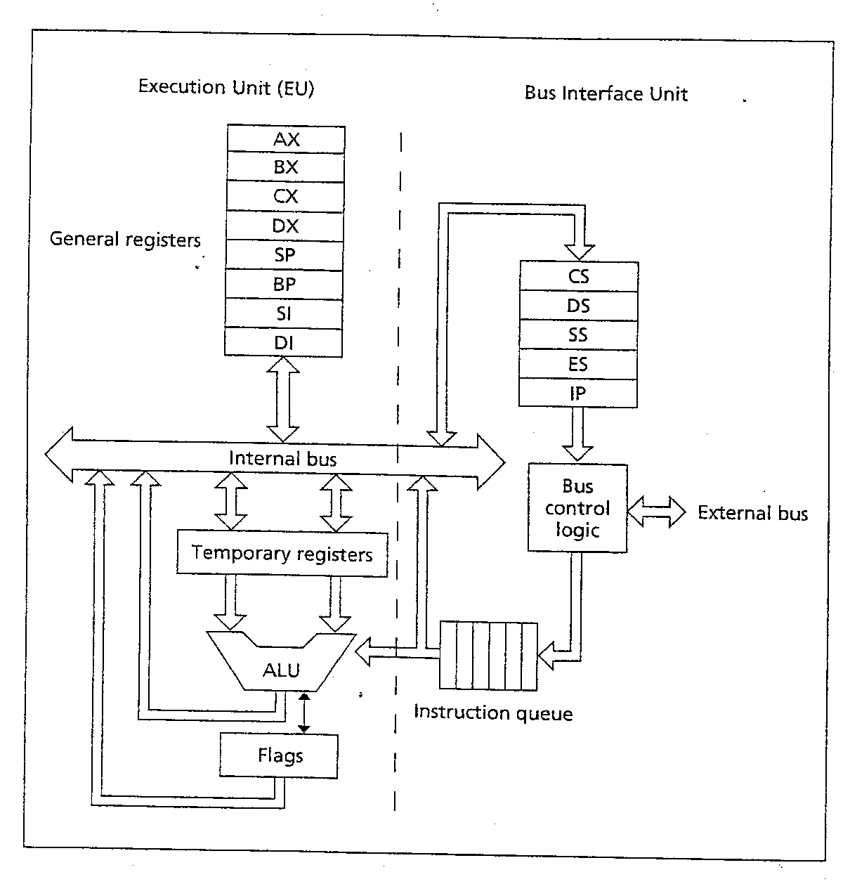
Organization of the 8088/8086

Slide 4
Organization of the 8088/8086
2 main components:
. Execution Unit (EU).
. Bus Interface Unit (BIU).
EU: ALU + Registers (AX, BX, CX, DX, SI, DI, BP, and SP) + FLAGS register.
ALU: performs arithmetic & logic operations.
Registers: store data
FLAGS register: Individual bits reflect the result of a computation.

Slide 5
Organization of the 8088/8086
BIU: facilitates communication between the EU & the memory or I/O circuits.
Responsible for transmitting addresses, data, and control signals on the buses.
Registers (CS, DS, ES, SS, and IP) hold addresses of memory locations.
IP (instruction pointer) contain the address of the next instruction to be executed by the EU.

Slide 6
Organization of the 8088/8086
16-bit registers, 1M Bytes Memory
Registers:
Information is stored in registers
Registers are classified according to the functions they perform

Slide 7
Registers
Data registers: 4 general data registers hold data for an operation.
Address registers: (segment, pointer and index registers) hold the address of an instruction or data.
Status register: FLAG register keeps the current states of the processor.
14 16-bit registers

Slide 8
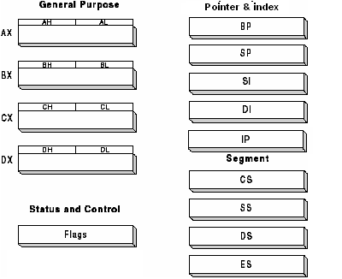
Register

Slide 9
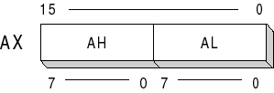
General Data Register: Used for general data manipulation.
They are 16-bit registers that can also be used as two 8 bit registers: low and high bytes can be accessed separately → more registers to use when dealing with byte-size data.
In addition to being general-purpose registers, they perform special functions

Slide 10
AX (Accumulator)
Most efficient register for arithmetic, logic operations and data transfer: the use of AX generates the shortest machine code.
In multiplication and division operations, one of the numbers involved must be in Al or AX
BX (Base)
Can hold addresses (offset)

Slide 11
CX (Counter)
Counter for looping operations: loop counter, in REP instruction, and in the shift and rotate bits
DX (Data):
Used in multiply and divide, also used in I/O operations

Slide 12
The 8086 processor
The 8086 processor assign a 20-bit physical address to its memory locations.
2 → 1 Mbytes
20 bits → 5 hex digits
first addresses: 00000, 00001,…,0000A,…FFFFF.
registers are 16-bits → can address only 2 = 64 K Bytes.
→ Partition the memory into segments
20
16

Slide 13
Memory Segment
16
Is a block of 2 (64) K Bytes consecutive memory bytes.
Each segment is identified by a 16-bit number called segment number, starting with 0000 up to FFFFh . Segment registers hold segment number.
Within a segment, a memory location is specified by giving an offset (16-bit) = It is the number of bytes from the beginning of the segment (0→ FFFFh).

Slide 14
Memory Segment
F0000
E0000
D0000
C0000
B0000
A0000
90000
8000:FFFF
80000
One Segment
8000:0000
70000
60000
50000
segment
offset
40000
30000
20000
10000
00000

Slide 15
Segment : Offset Address
A memory location may be specified by a segment number and offset ( logical address ).
Example :
A4FB : 4872
h
Segment
Offset

Slide 16
Offset : is the distance from the beginning to a particular location in the segment.
Segment number : defines the starting of the segment within the memory space.

Slide 17

Segmented Memory
one segment
linear addresses

Slide 18
Start location of the segment must be 20 bits → the absolute address is obtained by appending a hexadecimal zero to the segment number , i.e. multiplying by 16( 10_{h}).

Slide 19
Physical Address
Physical Address : is equal to
segment number X 10 + Offset
h

Slide 20
Physical Address for A4FB : 4872
A4FB0
+
4872
A9822 ( 20 bits )

Slide 21
Location of Segments
Segment 0
starts at address 0000:0000 → 00000
h
ends at address 0000:FFFF → 0FFFF
h

Slide 22
Location of Segments
Segment 1
starts at address 0001:0000 → 00010
h
ends at address 0001:FFFF → 1000F
h
Overlapping between segments

Slide 23
Segment Physical Address (hex)
…
10021
10020
End of Segment 2 1001F
1001E
…
10010
End of Segment 1 1000F
1000E
…
10000
End of Segment 0 0FFFF
0FFFE
…
00021
Start of Segment 2 00020
0001F
…
00011
Start of Segment 1 00010
0000F
…
00003
00002
00001
Start of Segment 0 00000

Slide 24
Location of Segments
The segments start every 10 = 16 bytes
( called Paragraph ) and the starting address of a segment always ends with a hex digit 0.
Paragraph boundary is an address divisible by 16.
16

Slide 25
Segments may overlap, the segment : offset form of an address is not unique
Example
For the memory location whose physical address is specified by 1256A (hex) , give the address in “ segment : offset “ form for the segments 1256 & 1240 .
Solution :
Physical address = segment X 10 + offset
offset = physical address – segment X 10

Slide 26
Solution
Segment 1256 :
offset = 1256A - 12560 = A
Address → 1256 : 000A
Segment 1240 :
offset = 1256A - 12400 = 0016A
Address → 1240 : 016A

Slide 27
Program Segments
A typical machine language program consists of:
  instructions ( CODES )
  data
  stack → is a data structure used by the processor to implement procedure calls.

Slide 28
Codes , data , and stack are loaded into different memory segments :
  Code segment CS : holds segment number of the code segment.
  Data Segment DS : holds segment number of the data segment.
  Extra Segment ES :extra segment : holds alternate segment number of the data segment.
  Stack Segment SS : holds segment number of the stack segment.

Slide 29
Program Segment
A program segment can occupy less than 64 Kbytes.
Overlapping permits program segments that are less than 64 KB to be placed close together.

Slide 30
- At any time, only those memory locations addressed by the 4 segment registers are accessible; → only 4 memory segments are active. However, the contents of a segment register can be modified by a program to address different segments.

Slide 31
Pointer and Index Registers
SP, BP, SI, DI
Used for offset of data, often used as pointers. Unlike segment registers, they can be used in arithmetic and other operations.

Slide 32
Pointer Registers
SP (Stack Pointer): Used with SS for accessing the stack segment.
BP ( Base Pointer): Used with SS to access data on the stack. However, unlike SP, BP can be used to access data in other segments.

Slide 33
Index Registers
SI (Source Index): Source of string operations. Used with DS (or ES).
DI (Destination Index): Destination of string operation. Used with ES (or DS).

Slide 34
Instruction pointer
  IP (Instruction pointer): Points to the next instruction. Used with CS.

Slide 35
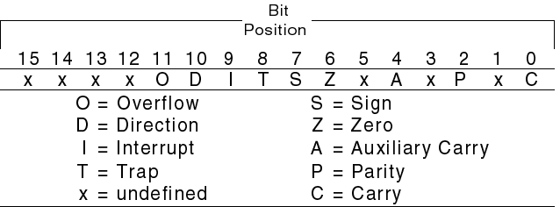
Flags register
Flags: Bits specify status of CPU and information about the results of the arithmetic operations.

Slide 36
Organization of the PC
A computer is made of: Hardware & software. Software controls the H/W operations.
The purpose of the OS is to coordinate the operations of all the devices that make up the computer systems.

Slide 37
Some of the OS functions
1) reading and executing the commands typed by the user.
2) performing I/O operations
3) generating error messages
4) managing memory and other resources.

Slide 38
Very popular O.S. for IBM PC is DOS.
DOS manage only 1 M byte memory, does not support multitasking.
DOS is a collection of routines that coordinates the operations of the computer. The routine that executes user command is COMMAND.COM.
Information stored on disk is organized into files. A file has a name and an optional extension.

Slide 39
The BIOS routines are used to perform I/O operations.
DOS routines operate over the entire PC family.
BIOS routines are machine specific.
The compatibility of PC clones with the IBM PC depends on how well their BIOS routines match those of the IBM PC
The addresses of BIOS routines (interrupt vectors) are placed in memory starting at 00000h.

Slide 40
I/O Ports Addresses
I/O devices are connected to the computer through I/O circuits. Each of them contains several registers called ports.
I/O ports have addresses I/O addresses .
8086/8088 supports 64 KB of I/O ports. Example: keyboard controller: 60 - 63
h
h

Slide 41
Start-up operation
When PC is powered on CS is set to FFFFh & IP is set to 0000h. PC executes the instruction with the address FFFF0h. This instruction transfers the control to the BIOS routines.
BIOS loads the boot program.
Boot program loads the OS and COMMAND.COM is given control

